Slide 1

First - Second Review
VigilEye
A Next-Generation Surveillance System for Abnormal Activity Detection
Presented By
Adhil Shah
(Igw20cs001)
Ahammed Musharaf N K
(Igw20cs002)
Ajil Benny
(Igw20cs003)
Muhammed Hashif V
(Igw20cs027)
Guided By :Ms .Thasni KM
Asst. Professor
CSE Dept, IIPE

Slide 2

CONTENTS
Abstract
Literature Review
Project Plan
System Design
Cost Estimation
Modules
Hardware Requirements
Software Requirements
Conclusion
References

Slide 3
ABSTRACT
In our ever-changing world, the demand for security is continually increasing. Insufficient surveillance contributes to a rise in various crimes every day.
Therefore, we are introducing a system that can operate automatically without the need for human intervention. This system includes an automated alerting feature.
The system comprises both hardware (camera and microcontroller) and software components for a holistic approach to surveillance.
Real-time visuals are efficiently streamed to cloud platforms such as AWS and GCP, enabling remote access and storage.
Machine learning models in the backend continuously monitor visuals, providing immediate alerts for abnormal activities, including fighting, stabbing, choking, crowd disturbances, and restricted access.
By seamlessly integrating AI into traditional security measures, the system offers a next-generation solution, proving valuable for home security and monitoring applications across diverse settings.

Slide 4
LITERATURE REVIEW
Motion Influence Map for Unusual Human Activity Detection and Localization in Crowded Scenes
Anomaly Detection in Crowded Scenes
Motion-based unusual event detection in human crowds
AI Based Smart Surveillance System

Slide 5
1
2
3
4
1
Motion Influence Map for Unusual Human Activity Detection and Localization in Crowded Scenes
The paper introduces a unique approach to detecting unusual human activities in crowded scenes by using a motion influence map instead of traditional methods like human detection or segmentation.
The proposed motion influence map is a key feature, effectively capturing motion characteristics like speed, direction, and object/subject size and interactions within frame sequences.
The developed framework based on the motion influence map enables the detection of both global and local unusual activities, providing a simple localization method.
Advantages
Disadvantages
Comprehensive Motion Capture
Versatile Detection Framework
Simplified Localization
Dependency on Representational Power
Complexity in Implementation
Limited Generalizability

Slide 6
1
2
3
4
2
Anomaly Detection in Crowded Scenes
The paper introduces a novel framework for anomaly detection in crowded scenes, focusing on a localized video representation.
The framework emphasizes the joint modeling of appearance and dynamics, and the detection of both temporal and spatial abnormalities, forming a comprehensive approach.
Through an experimental evaluation with a new dataset of crowded scenes, the proposed representation demonstrates superiority over various state-of-the-art anomaly detection techniques.
Advantages
Disadvantages
Comprehensive Model Design
Effective Handling of Abnormalities
Superior Performance
Complex Model Design
Dataset Specificity
Resource Intensity

Slide 7
1
2
3
4
Motion-based unusual event detection in human crowds
3
The paper addresses the significant challenge of analyzing human crowds in video surveillance, particularly considering the non-rigid nature of their shapes.
The proposed method employs optical flows to estimate and then cluster human crowds into groups using an unsupervised approach called Adjacency-Matrix based Clustering (AMC).
The clusters' behaviors, including attributes, orientation, position, and crowd size, are characterized by a force field model. The system predicts human crowd behaviors based on this model and detects anomalies in surveillance scenes.
Advantages
Disadvantages
Innovative Clustering Approach
Comprehensive Behavior Characterization
Effective Anomaly Detection
Complexity in Implementation
Dataset Specific Evaluation
Resource Intensive

Slide 8
1
2
3
4
4
AI Based Smart Surveillance System
The paper highlights the increasing demand for AI-based smart surveillance systems driven by the need for heightened safety and security.
The proposed system aims to autonomously analyze video, image, and audio data without human intervention, utilizing advancements in computer vision, sensor devices, and AutoML.
Unlike traditional systems, the AI-based surveillance system in this project enables live decision-making and predictive analysis, offering swift alerts for various public departments like police, health, and fire in response to incidents.
Advantages
Disadvantages
Autonomous Decision Making
Multi-Departmental Applicability
Quick Alert System
Dependence on Training Modules
Potential Ethical Concerns
Implementation Challenges

Slide 9
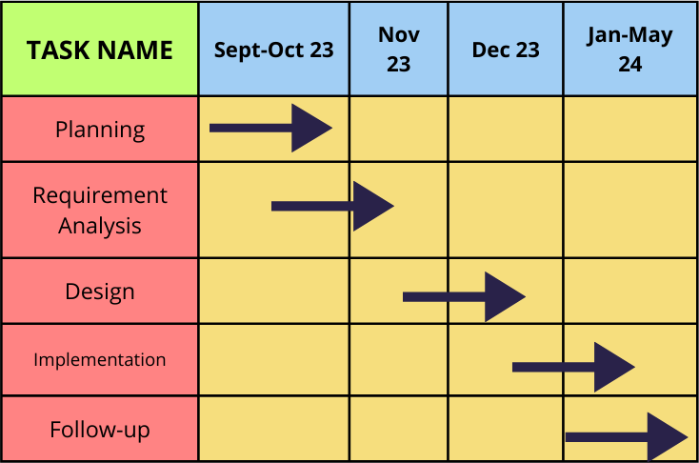
PROJECT PLAN

Slide 10
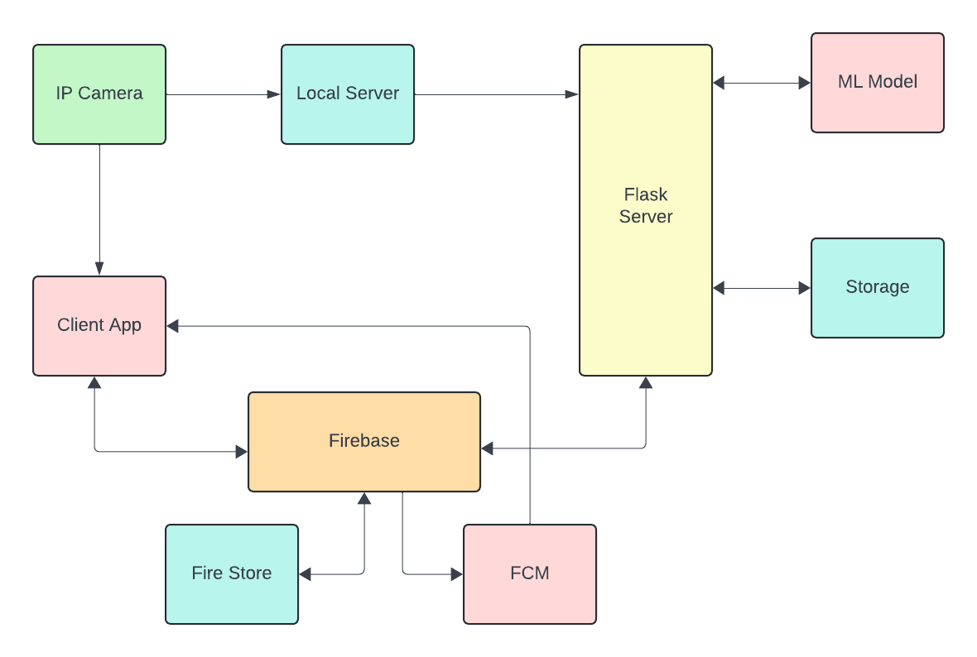
SYSTEM DESIGN

Slide 11
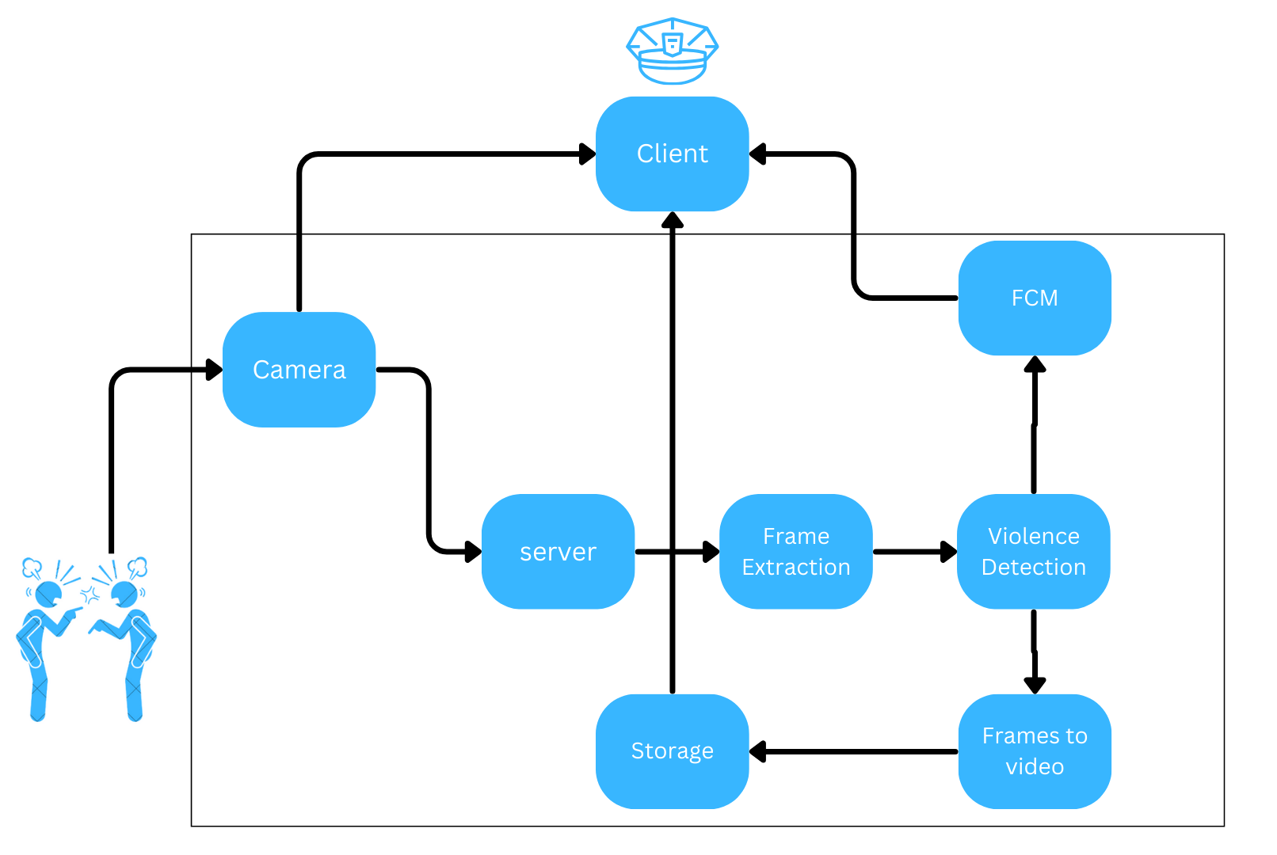
USE CASE DIAGRAM

Slide 12
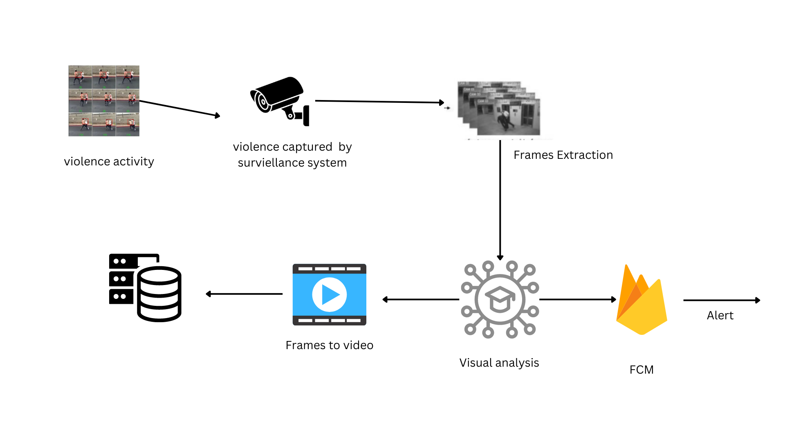
Architecture of the system

Slide 13
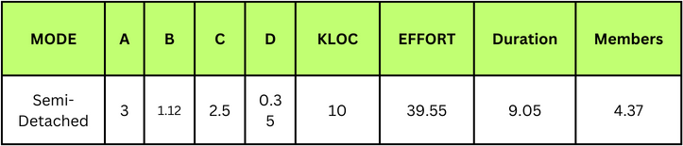
COST ESTIMATION
KLOC ~ 10 KLOC
Effort = a*KLOC^{b}
Duration = c*effort^{d}
Members = Effort / Duration

Slide 14
MODULES
Data Collection
Model Development
Training
Testing
Deployment
Data Preprocessing

Slide 15
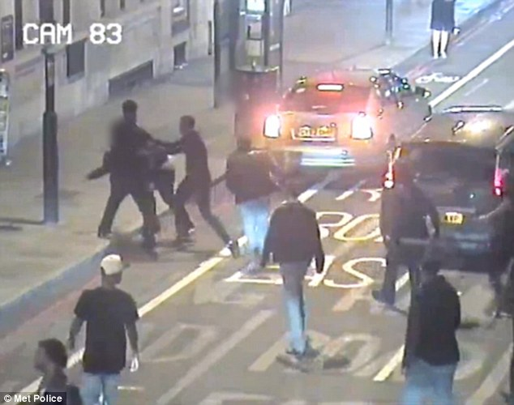

1.
Abnormal Activity Detection
Employ AI to detect abnormal actions in video footage, strengthening surveillance systems for improved safety.

Slide 16

2.Auto Alerting
Automatically generate alerts for abnormal activities, ensuring quick responses and proactive security measures.

Slide 17
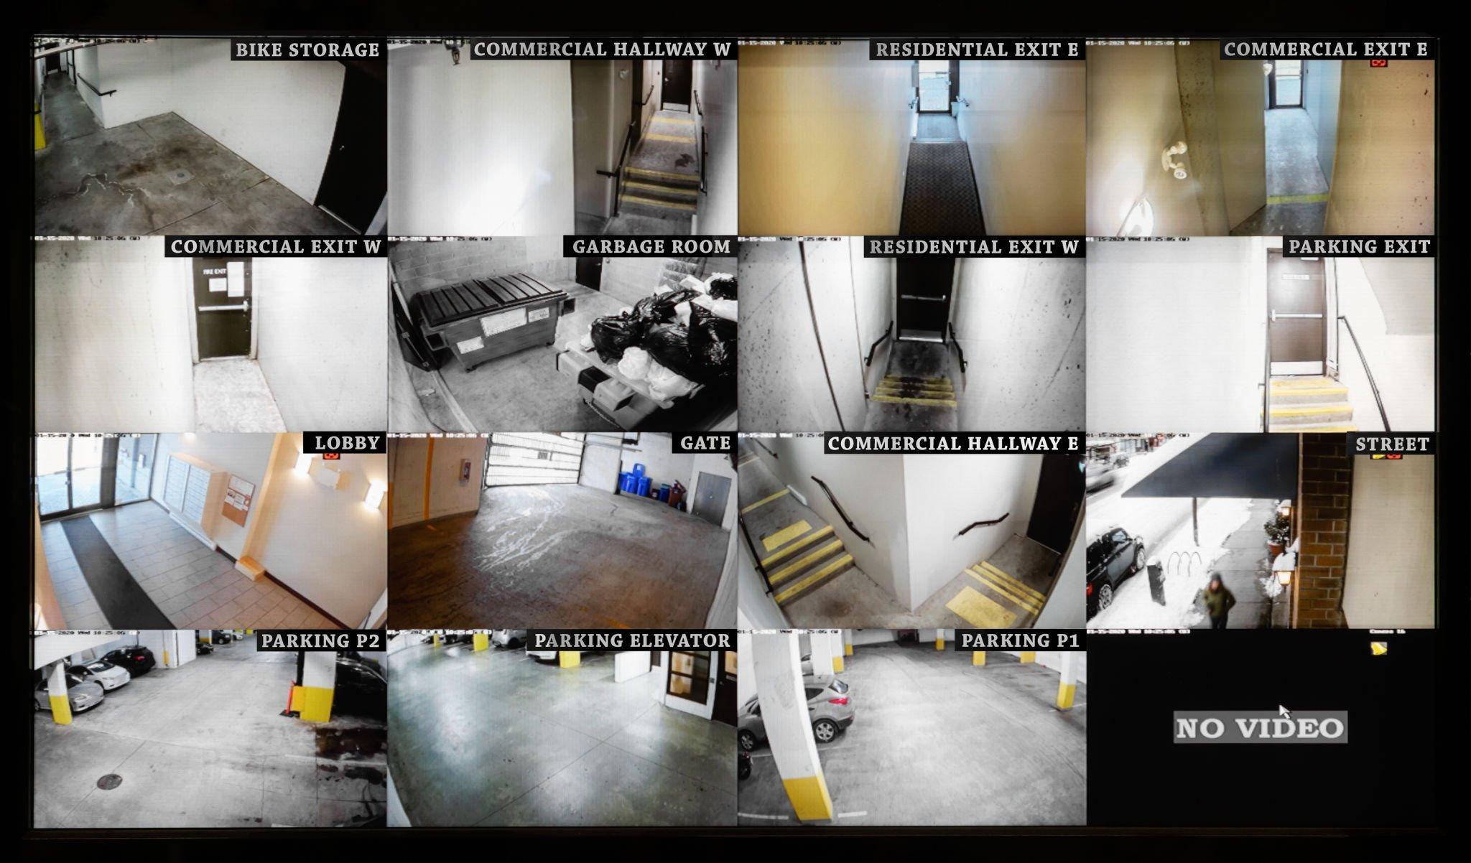
3.Incident Video Segmentation
Break down video sequences into 30-second segments for organized incident analysis, aiding efficient storage and retrieval.

Slide 18
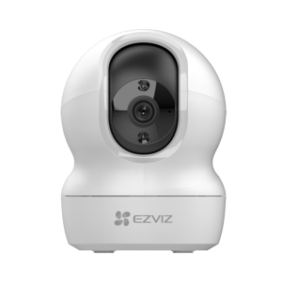
Hardware Requirements
IP Camera

Slide 19







Software Requirements
React Native

Slide 20
The system processes live video streams frame by frame using OpenCV, extracting visual data for analysis.
A pre-trained convolutional neural network (CNN) implemented in Keras identifies patterns of violent behavior within the video frames.
The system identifies potential violent incidents by recognizing continuous sequences of frames with consistently high violence prediction scores, helping to reduce false alarms.
Upon detecting violent behavior, the system generates a video clip and triggers real-time alerts to authorities via Firebase Cloud Messaging (FCM) with location and timestamp details.

Slide 21
5. The system is built on a Flask web application framework and leverages cloud-based services for scalability, reliability, and real-time responsiveness through multithreaded processing

Slide 22
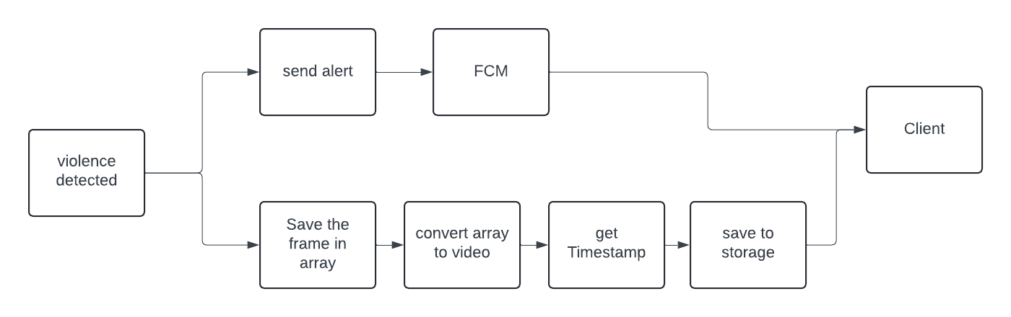

Slide 23


Result
Splash Screen
Lock Screen

Slide 24


Result
Add Camera
Camera list

Slide 25

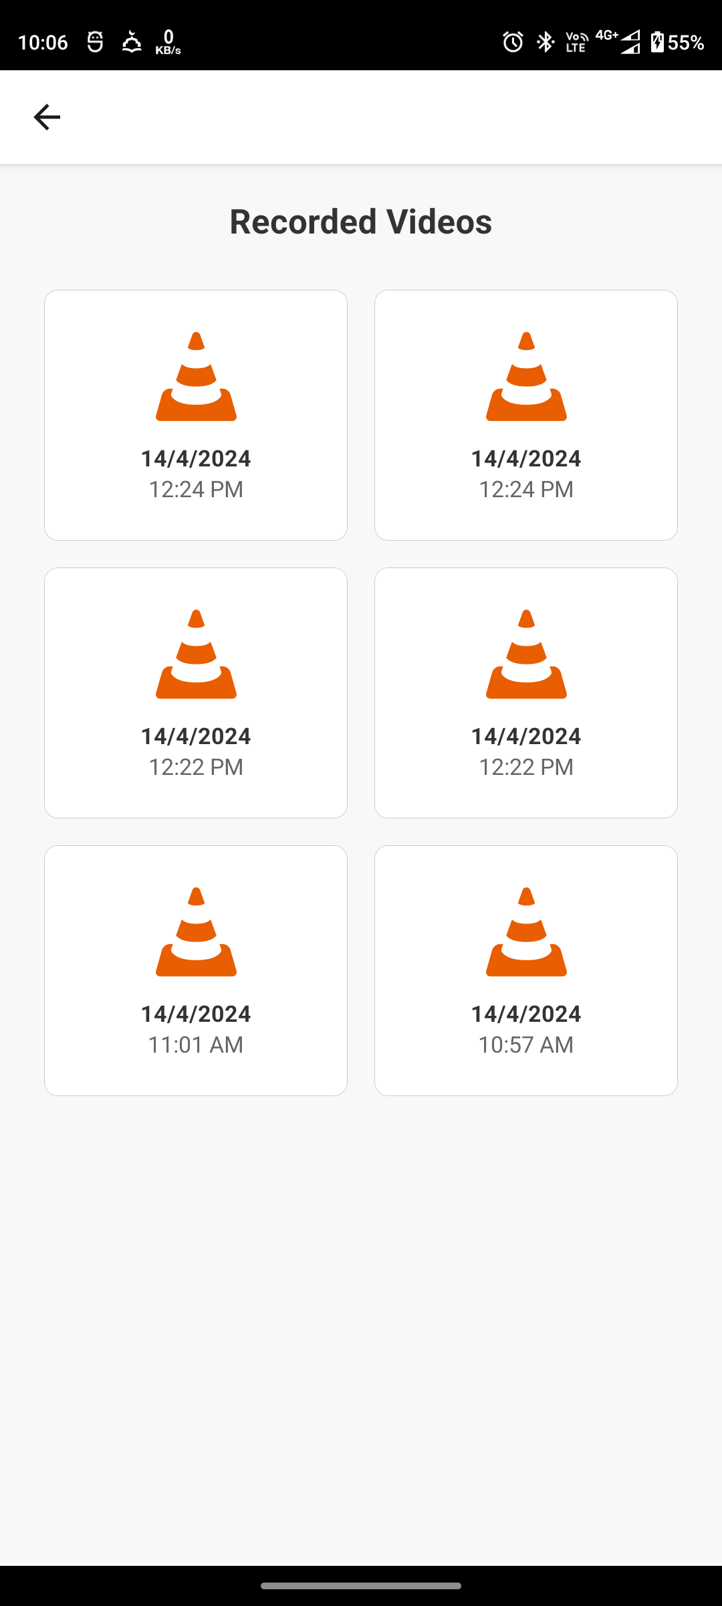
Result
Recorded Videos
Live View

Slide 26

Result
Recorded Video View

Slide 27
Conclusion
AI-driven smart surveillance represents a cutting-edge solution for enhanced safety and security.
The system's autonomous video analysis and alerting capabilities offer a proactive approach to identifying abnormal activities.
By integrating cloud platforms like AWS and GCP, real-time visuals can be accessed remotely, providing users with timely information.
The inclusion of machine learning models for video analysis greatly improves the accuracy and responsiveness of the system.
In the future, to further enhance its capabilities, predictive analysis can be integrated. This will allow the system to anticipate and prevent security incidents based on historical data and trends.

Slide 28
References
T.Bouwmans, F. El Baf, and B. Vachon, Statistical background modeling for foregrounddetection: A survey,
Handbook of Pat tern Recognit ion and Computer Vision (Volume 4). Singapore: World Scient ific, 2010.
T. Bouwmans, Recent advanced statistical background modeling for foreground detection: A systematic survey, Recent Patents
Comput . Sci. 4 (2011) 147–176.
Motion Influence Map for Unusual Human Activity Detection and Localization in Crowded Scenes https://ieeexplore.ieee.org/document/7024902?section=abstract
Anomaly Detection in Crowded Scenes
https://www.researchgate.net/publication/221362278_Anomaly_Detection_in_Crowded_Scenes
Motion-based unusual event detection in human crowds
https://www.researchgate.net/publication/220278263_Motion-based_unusual_event_detection_in_human_crowds

Slide 29
THANK YOU

